Slide 1
DSA- CS2002
Data Structures: Trees, Binary, k-ary & Traversals

Slide 2
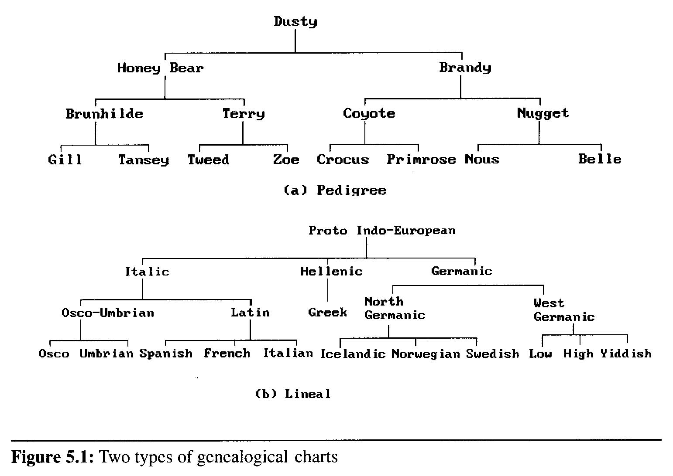
Trees
(ref 11.1 Data Structures in C++)
A tree is a non-linear data structure in which the data are organized so that items of information are related by branches
Examples:

Slide 3
Definition : A tree is a finite set of one or more nodes such that
  There is a specially designated node called root.
  The remaining nodes are partitioned into n>=0 disjoint set T₁,…,T_{n}, where each of these sets is a tree. T₁,…,T_{n} are called the subtrees of the root.
Every node in the tree is the root of some subtree

Slide 4
Some Terminology
  node: the item of information plus the branches to each node.
  degree: the number of subtrees of a node
  degree of a tree: the maximum of the degree of the nodes in the tree.
  terminal nodes (or leaf): nodes that have degree zero
  nonterminal nodes: nodes that don’t belong to terminal nodes.
  children: the roots of the subtrees of a node X are the children of X
  parent: X is the parent of its children.

Slide 5
Some Terminology (cont’d)
  siblings: children of the same parent are said to be siblings.
  Ancestors of a node: all the nodes along the path from the root to that node.
  The level of a node: defined by letting the root be at level one. If a node is at level l, then its children are at level l+1.
  Height : the maximum level of any node in the tree

Slide 6
Example
  A is the root node
  B is the parent of D and E
  C is the sibling of B
  D and E are the children of B
  D, E, F, G, I are external nodes, or leaves
  A, B, C, H are internal nodes
  The level of E is 3
  The height of the tree is 4
  The degree of node B is 2
  The degree of the tree is 3
  The ancestors of node I is A, C, H
  The descendants of node C is F, G, H, I
Level
A
1
B
C
2
H
3
D
E
F
G
I
4

Slide 7
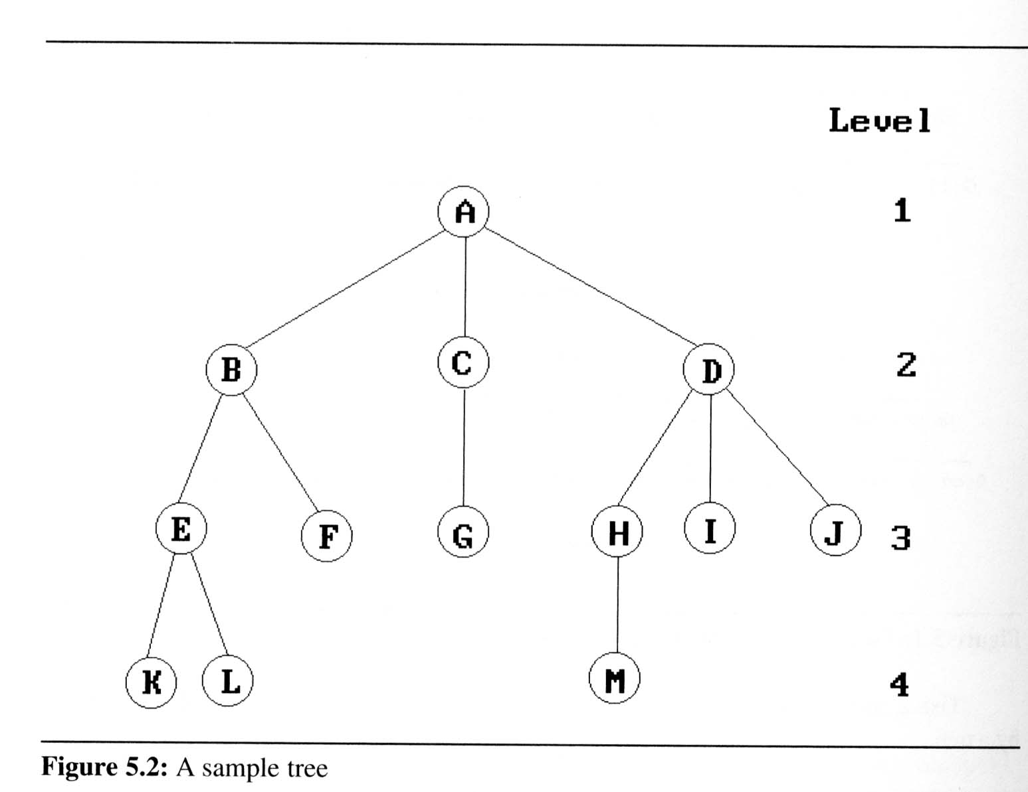
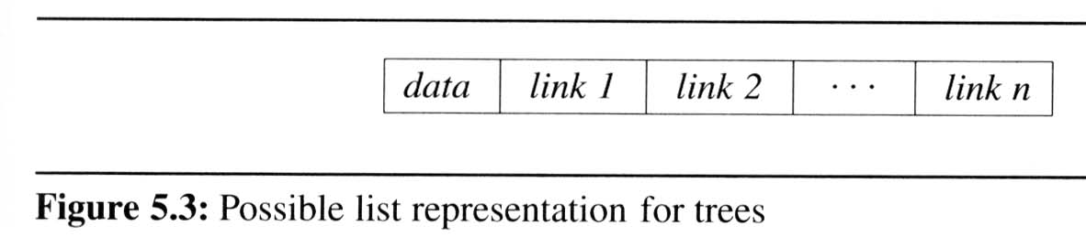
Representation Of Trees
  List Representation
    we can write of Figure 5.2 as a list in which each of the subtrees is also a list
  ( A ( B ( E ( K, L ), F ), C ( G ), D ( H ( M ), I, J ) ) )
    The root comes first,
    followed by a list of sub-trees

Slide 8
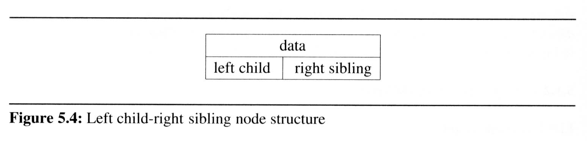
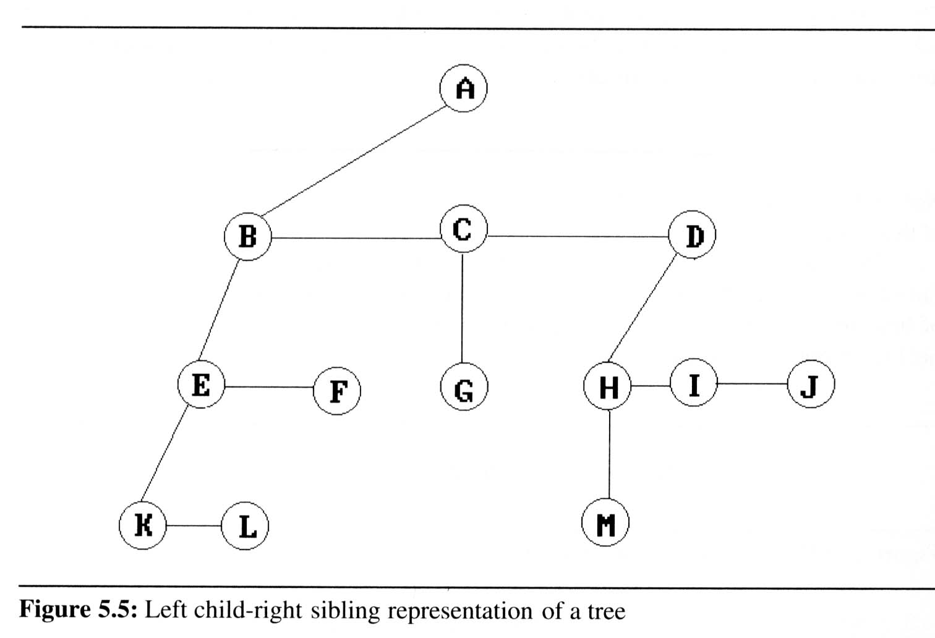
Representation Of
Trees (cont’d)
  Left Child-
  Right Sibling
  Representation

Slide 9
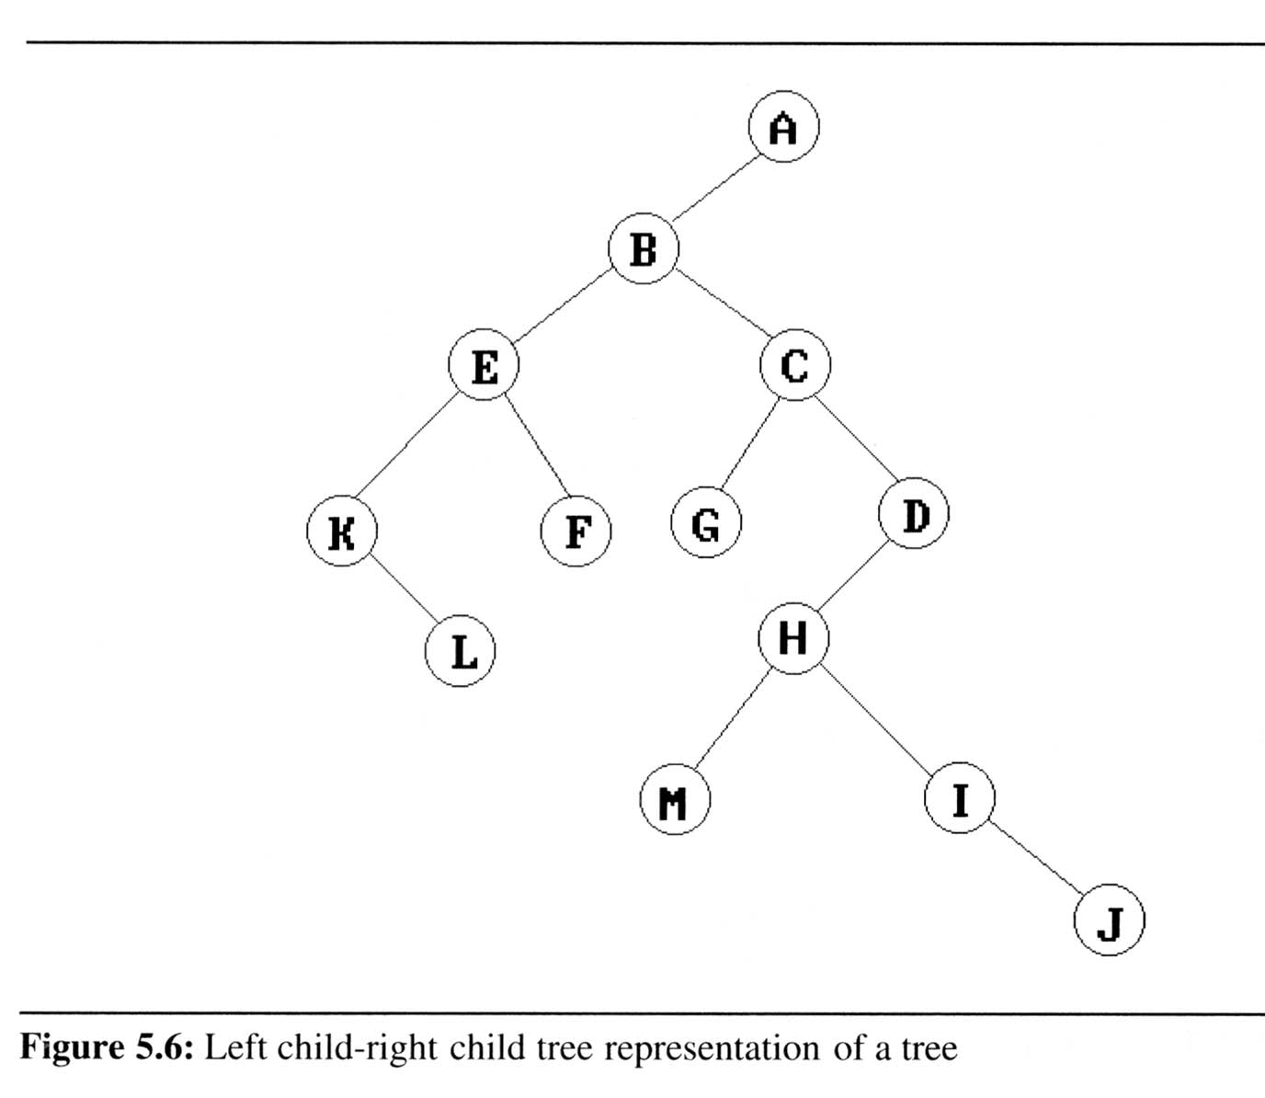
Representation Of Trees (cont’d)
  Representation
  As A Degree
  Two Tree

Slide 10
Binary Trees
(ref 11.2 Data Structures in C++)
Binary trees are characterized by the fact that any node can have at most two branches
Definition (recursive):
  A binary tree is a finite set of nodes that is either empty or consists of a root and two disjoint binary trees called the left subtree and the right subtree
Thus the left subtree and the right subtree are distinguished
Any tree can be transformed into binary tree
  by left child-right sibling representation
A
A
B
B

Slide 11
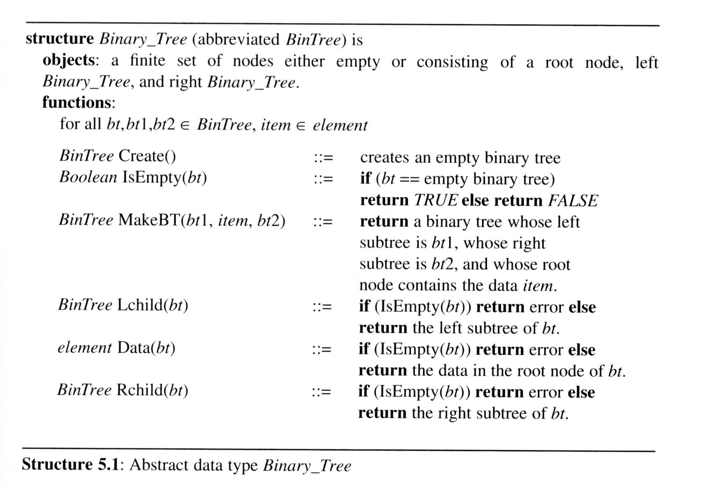
Binary Trees
The abstract data type of binary tree

Slide 12
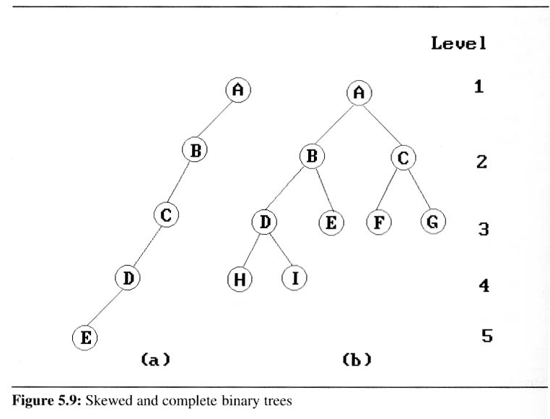
Binary Trees
Two special kinds of binary trees:
(a) skewed tree, (b) complete binary tree
  The all leaf nodes of these trees are on two adjacent levels

Slide 13
Properties of binary trees
  Lemma [Maximum number of nodes]:
  The maximum number of nodes on level i of a binary tree is 2^{i-1}, i ≥1.
  The maximum number of nodes in a binary tree of depth k is 2^{k}-1, k≥1.
  Lemma [Relation between number of leaf nodes and degree-2 nodes]:
  For any nonempty binary tree, T, if n₀ is the number of leaf nodes and n₂ is the number of nodes of degree 2, then n₀ = n₂ + 1.
These lemmas allow us to define full and complete binary trees

Slide 14
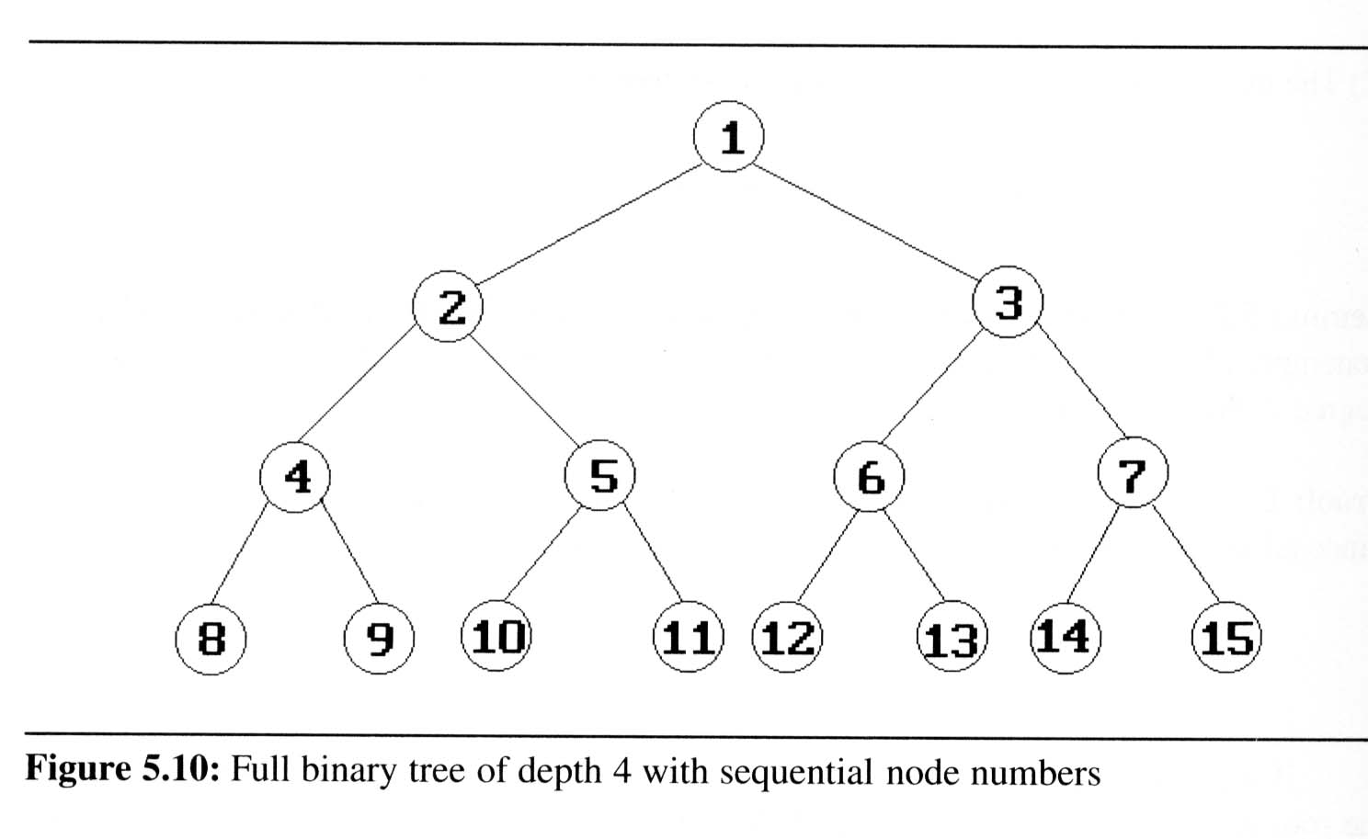
Definition:
  A full binary tree of depth k is a binary tree of depth k having 2^{k}-1 nodes, k ≥ 0.
  A binary tree with n nodes and depth k is complete iff its nodes correspond to the nodes numbered from 1 to n in the full binary tree of depth k.
  From Lemma 5.1, the
  height of a complete
  binary tree with n nodes
  is ⎡log₂(n+1)⎤

Slide 15
Homework
If a tree has exactly 75 nodes, can it be a full binary tree? Why or why not?
What is the height of a complete binary tree having exactly 35 nodes?
What is the minimum height of a binary tree that contains 91 nodes?

Slide 16
Binary tree representations (using array)
Lemma : If a complete binary tree with n nodes is represented sequentially, then for any node with index i, 1 ≤ i ≤ n, we have
  parent(i) is at ⎣i /2⎦ if i ≠ 1.
  If i = 1, i is at the root and has no parent.
  LeftChild(i) is at 2i if 2i ≤ n.
  If 2i > n, then i has no left child.
  RightChild(i) is at 2i+1 if 2i+1 ≤ n.
  If 2i +1 > n, then i has no right child
A
1
[1]
[2]
[3]
[4]
[5]
[6]
[7]
B
2
C
3
A B C — D — E
Level 1
D
E
Level 2
Level 3
4
5
6
7

Slide 17
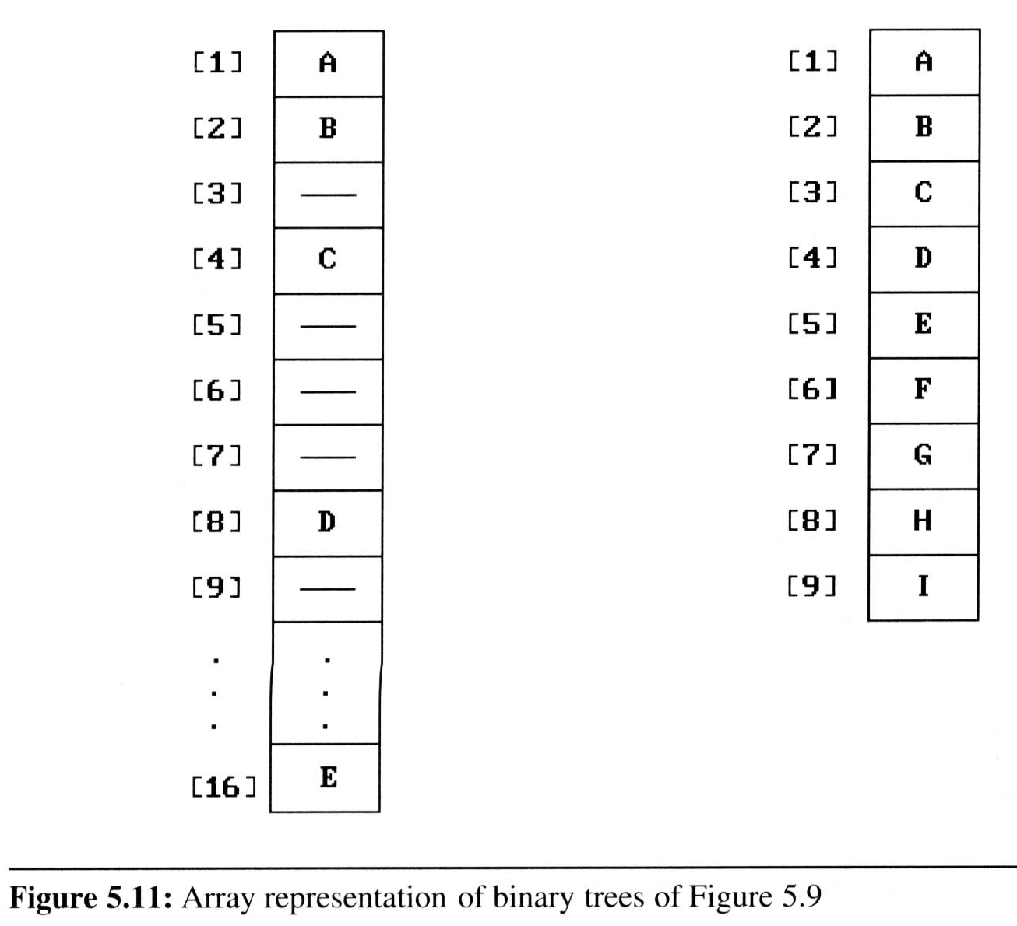
Binary tree representations (using array)
  Waste spaces: in the worst case, a skewed tree of depth k requires 2^{k}-1 spaces. Of these, only k spaces will be occupied
  Insertion or deletion
  of nodes from the
  middle of a tree
  requires the
  movement of
  potentially many nodes
  to reflect the change in
  the level of these nodes

Slide 18
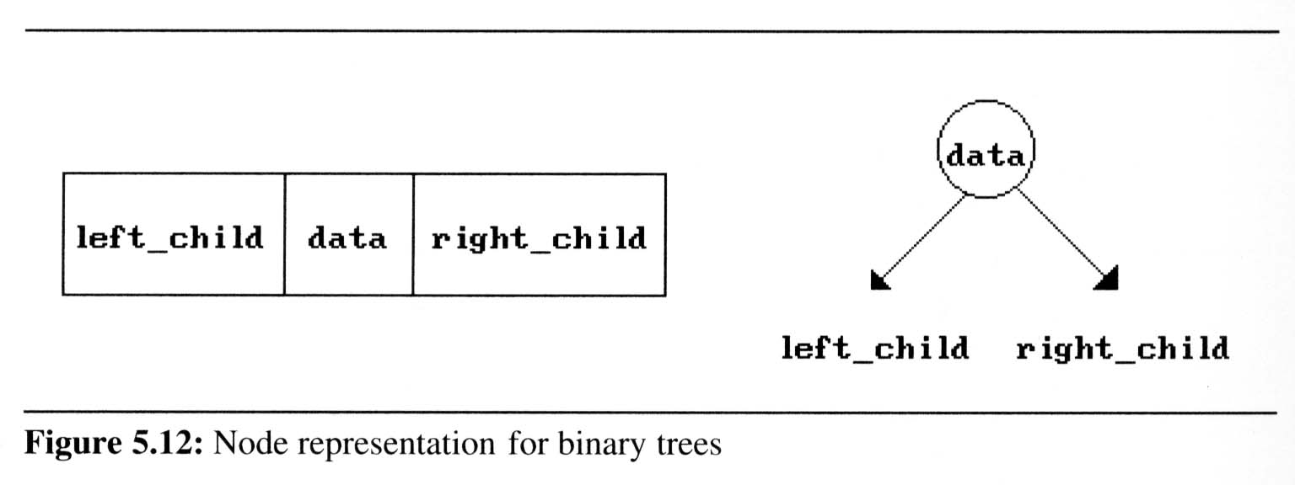
Binary tree representations (using link)
Template <class element>
class BTreeNode
{private:
BTreeNode *LeftChild;
element data;
BTreeNode *RightChild;
Public://constructor and getter setters
};
Template<class element>
class BinaryTree
{ public: //tree operations
private: BTreeNode<element> *root;
};

Slide 19
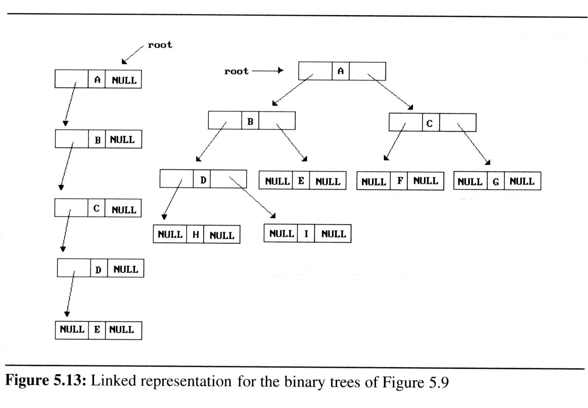
Binary tree representations (using link)

Slide 20
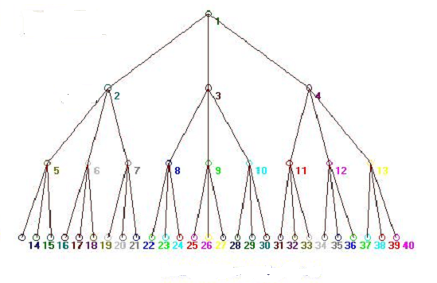
K-ary Trees
(also called n-ary or m-ary trees)
A k-ary tree is either empty or consists of a root node which is itself connected to an ordered sequence of a maximum of k trees that are themselves k-ary trees.
e.g. 3-ary tree

Slide 21
Homework
Create a full binary tree of height 3. Show one representation of this tree as an array, i.e., contents are kept in the memory in an array. Also give the formulas that one can use to access items in this tree.
Show a representation of a 3-ary tree as an array, i.e., contents are kept in the memory in an array. Also give the formulas that one can use to access items in this tree.
What is the maximum number of nodes in a 3-ary tree of height h?
Check general formula for k-ary tree (k^{h} – 1)/k-1
What is the minimum height of a 3-ary tree with n nodes. ⎡log₃(2n+1)⎤
Check general formula ⎡log_{k}((k-1)n+1)⎤ for k-ary tree

Slide 22
Binary Tree Traversals
(ref 11.6 Data Structures in C++)
How to traverse a tree or visit each node in the tree exactly once?
  There are six possible combinations of traversal
LVR, LRV, VLR, VRL, RVL, RLV
  Adopt convention that we traverse left before
  right, only 3 traversals remain
LVR (inorder), LRV (postorder), VLR (preorder)
left_child
data
right_child
V
:
visiting
node
L: moving left
R: moving right

Slide 23
The other traversals are the reverse of these three standard ones
That is, the right subtree is traversed before the left subtree is traversed
Reverse Preorder : VRL
Reverse Inorder : RVL
Reverse Postorder : RLV

Slide 24
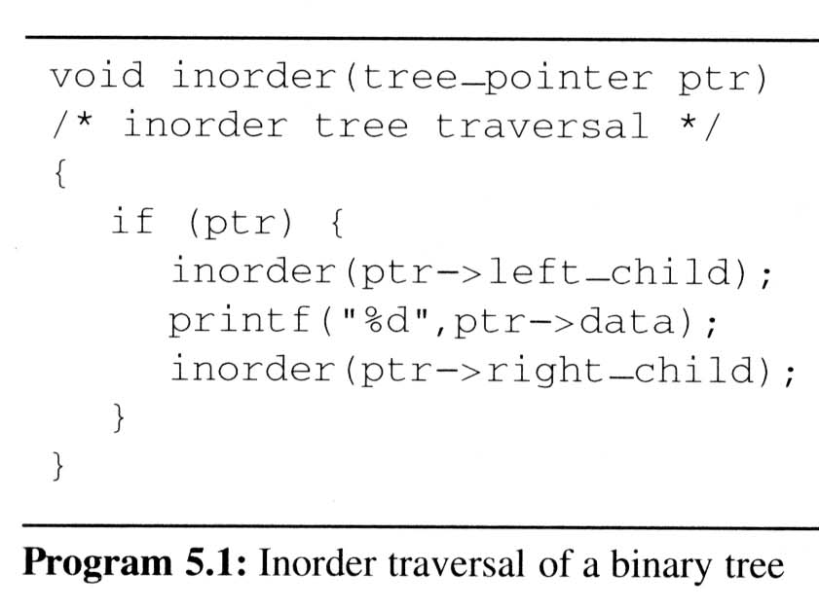
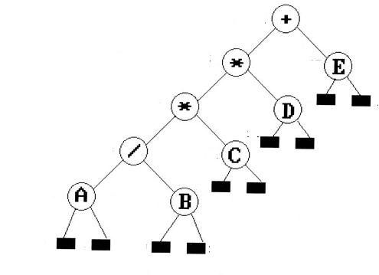
Binary Tree Traversals
Inorder traversal (LVR) (recursive version)
Output :A / B * C * D + E
L
V
R

Slide 25
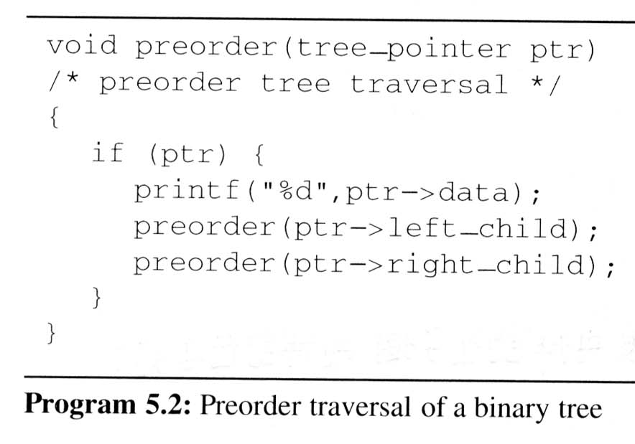
Binary Tree Traversals
Preorder traversal (VLR) (recursive version)
output:
+
*
*
/
A
B
C
D
E
V
L
L
R

Slide 26
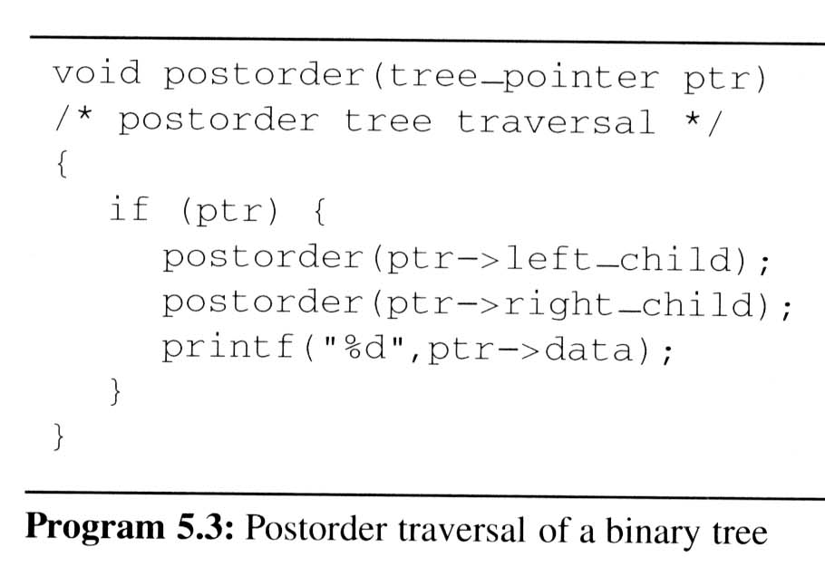
Binary Tree Traversals
Postorder traversal (LRV) (recursive version)
output:
A
B
/
C
*
D
*
E
+
L
R
V

Slide 27
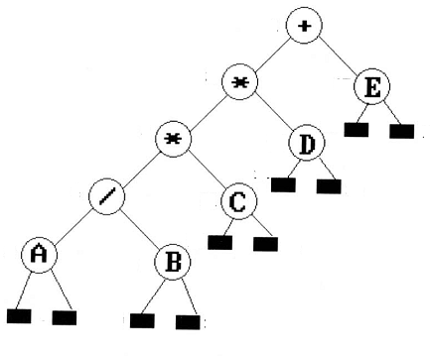
Binary Tree Traversals
Non-recursive Iterative Inorder Traversal (LVR)
Uses stack to simulate recursion
void Tree::NonrecInorder()
{ Stack s;
BNode *CurrentNode = root;
while(1)
{ while( CurrentNode)
{ s.Push(CurrentNode);
CurrentNode = CurrentNode.LeftChild;
}
If (! s.IsEmpty()
{ CurrentNode = s.Pop();
cout << CurrentNode.data << endl;
CurrentNode = CurrentNode.RightChild;
} else break;
}
}
Output :A / B * C * D + E

Slide 28
Binary Tree Traversals
Analysis of inorder(Non-recursive Inorder traversal)
  Let n be the number of nodes in the tree
  Time complexity: O(n)
    Every node of the tree is placed on and removed
    from the stack exactly once
  Space complexity: O(n)
    equal to the depth of the tree which
    (skewed tree is the worst case)

Slide 29
Level-Order Traversal
Level-order traversal (also called breadth-first traversal)
  method:
    We visit the root first, then the root’s left child, followed by the root’s right child.
    We continue in this manner, visiting the nodes at each new level from the leftmost node to the rightmost nodes
  This traversal requires a queue to implement

Slide 30
Level-Order Traversal using a queue
void Tree::LevelOrder()
{
Queue q;
TreeNode *CurrentNode = root;
while (CurrentNode)
{
cout << CurrentNode->data << ‘ ‘;
if (CurrentNode->LeftChild)
q.put(CurrentNode->LeftChild);
if (CurrentNode->RighttChild)
q.put(CurrentNode->RightChild);
CurrentNode = q.get();
}
}
Output : + * E * D / C A B

Slide 31
Binary Tree Traversals
Arithmetic Expression using binary tree
  inorder traversal (infix expression)
  A / B * C * D + E
  preorder traversal (prefix expression)
  + * * / A B C D E
  postorder traversal
  (postfix expression)
  A B / C * D * E +

Slide 32
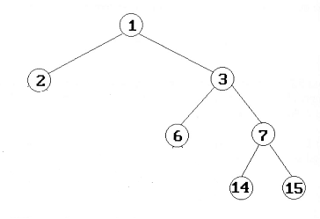
Homework
Try exercises 12 to 19 of chapter 11 of textbook.
Give preorder, inorder, postorder, level order, reverse preorder, reverse inorder and reverse-postorder traversals for the binary tree shown
2. Write a non-recursive
function making use of
stack for Postorder (LRV)
traversal of a binary tree

